Slide 1
如何借助Web of Science（SCI…) 开展创新性研究
杨习斌
手机：13401089564
QQ：81311540
邮箱：Orson.yang@thomsonreuters.com
汤森路透科技信息服务有限公司

Slide 2

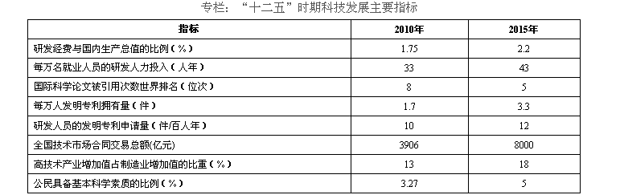
2011年7月科技部发布《国家十二五科学和技术发展规划》
发展规划附录：重要指标和名词解释
国际科学论文被引用次数：国际科学论文被引用次数是指被科学引文索引（SCI、SSCI）收录的学术论文在发表后的一段时间内被引用的次数之和。

Slide 3
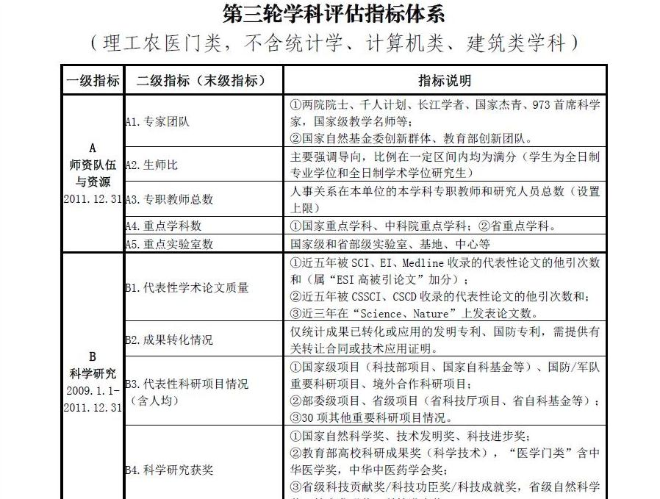
Notes:
缓解SCI的痛，利用SCI轻松科研

Slide 4

厦门大学论文情况

Slide 5
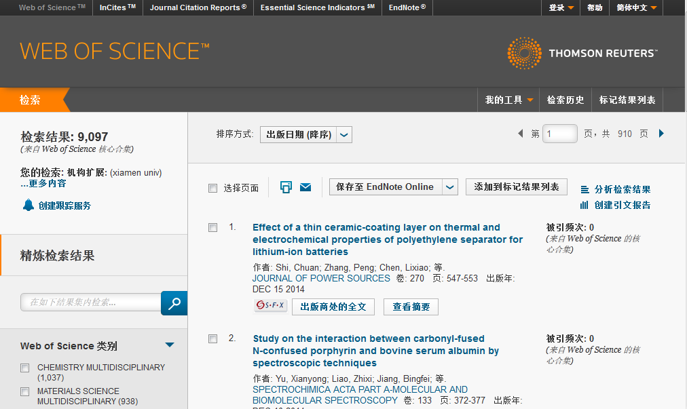
厦门大学论文情况

Slide 6
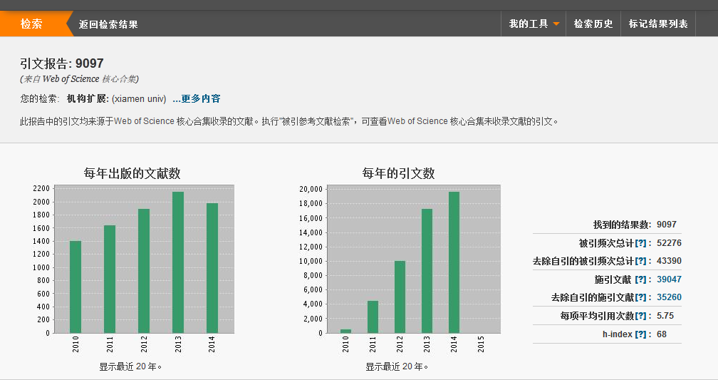
厦门大学论文情况（引文报告）

Slide 7
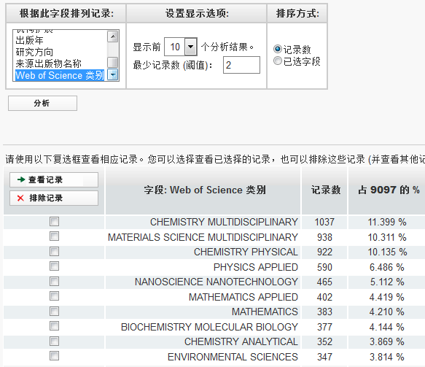
厦门大学论文情况（分析结果-研究方向）
化学多学科
材料多学科
物理化学
应用物理
纳米技术
应用数学

Slide 8
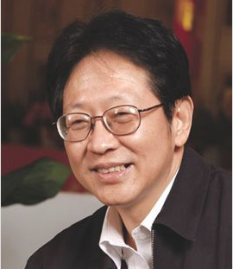
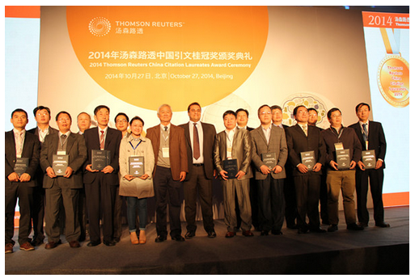
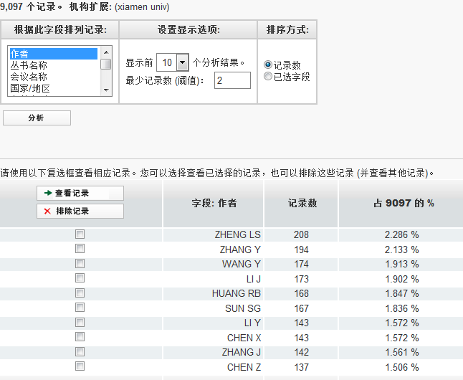
厦门大学论文情况（分析结果-作者）
郑兰荪院士

Slide 9
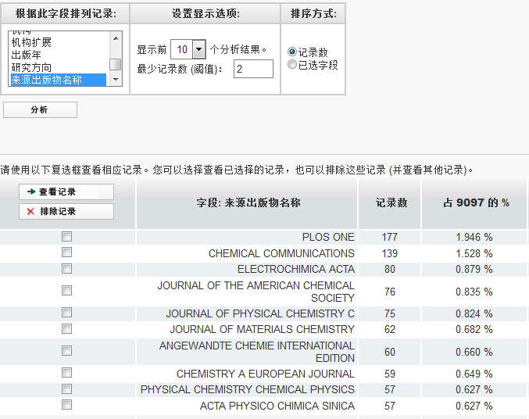
厦门大学论文情况（分析结果-期刊）

Slide 10
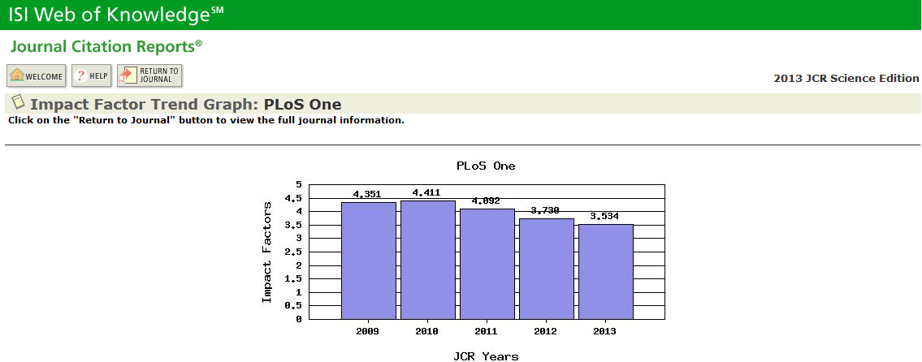
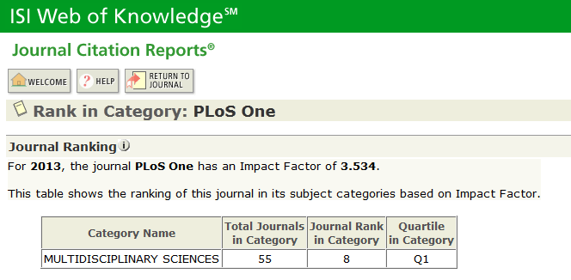
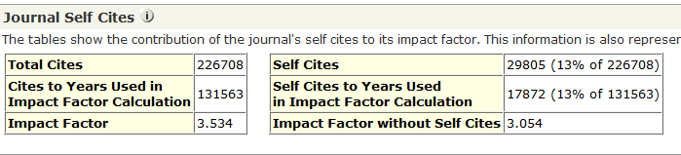
厦门大学论文情况（分析结果-期刊）

Slide 11
纲要
提高科研效率的有效途径
如何快速获取最有价值的学术科研参考文献
如何利用Web of Science(SCI…)进行创新性的研究
如何利用Web of Science(SCI…)订制文献情报跟踪
如何利用EndNote Web管理和格式化参考文献

Slide 12

提高科研效率的有效途径
科学研究的基本工作流程
Synthesis of Amino Acids
Synthesis of Amino Acids
开题
1JACS 1995
2JOC 1987
成果
发现
(Discovery)
Synthesis of Amino Acids
文献
1JACS 1995
2JOC 1987
实验
论证 (Test)
确定
方法
(Way)
实践
(Practice)
寻找
思路
(Find)
想法(Idea)

Slide 13
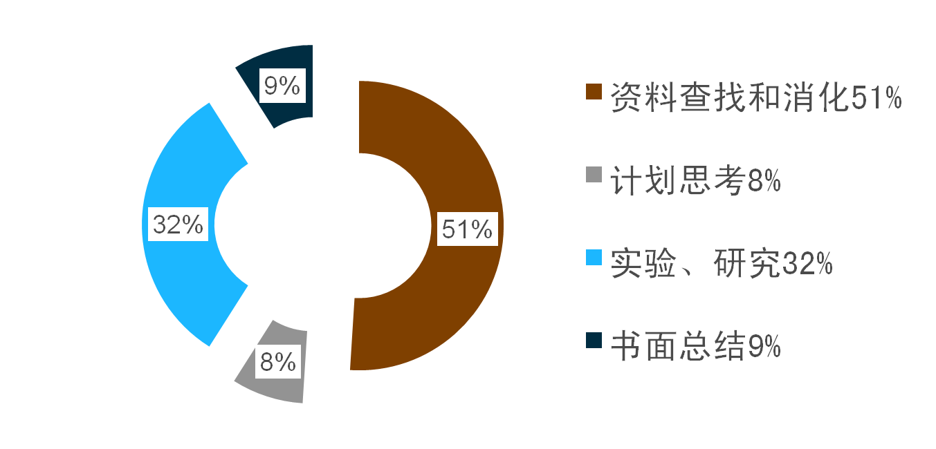
提高科研效率的有效途径
（NSF）美国科学基金会统计数据

Slide 14
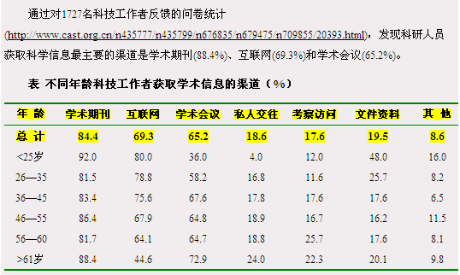
如何快速获取最有价值的科研参考信息
科研人员获取科学信息的主要途径

Slide 15
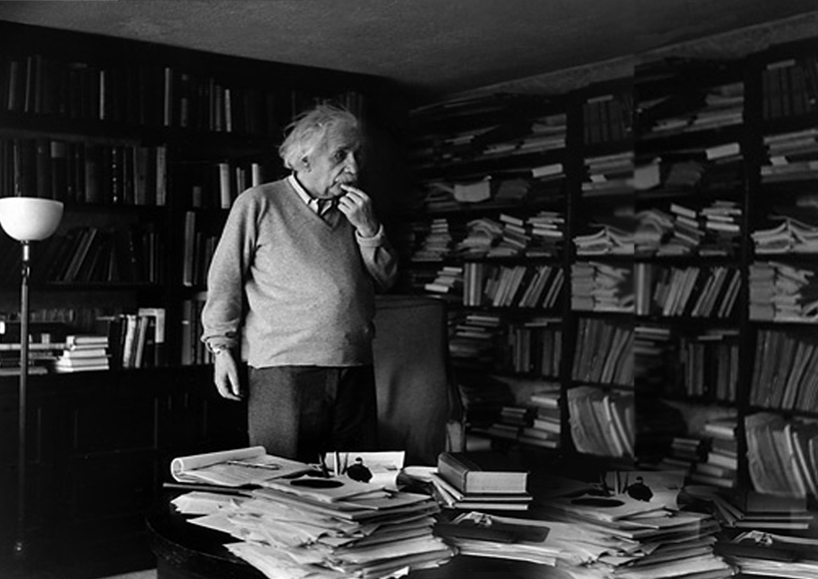
Where is it ？

Slide 16

如何快速获取最有价值的科研参考信息
如何从浩瀚文献中快速锁定跟科研课题最相关的前沿参考信息?
权威的参考数据
科学的检索方式
快速全面的分析

Slide 17
科技文献的获取和利用
文献的类型
零次文献：口头信息、未公开发表的文字资料（手稿、书信、笔记等）；时效性强；大量而无序
一次文献：期刊论文、专利文献、科技报告、会议录等；研究人员最终索取的文献
二次文献：检索工具；如SCI、EI、CA、Medline\Pubmed
三次文献：选用大量有关的文献，经过综合、分析、研究而编写出来的文献。 如：综述、评论、评述、进展、动态 等；研究人员最终需要的文献

Slide 18
科研人员与科学信息的获取和利用
科研过程中合理利用文献
研究人员的文献平台可以由二次文献作为入口，满足整体的需求；然后，通过这个入口来获取有用的高质量的全文期刊（一、三次文献）来满足纵深的研究需要。

Slide 19

SCI的诞生
Dr. Garfield 1955年在 Science 发表论文提出将引文索引作为一种新的文献检索与分类工具
  将一篇文献作为检索字段从而跟踪一个Idea的发展过程
1963年出版 Science Citation Index
1973年出版 Social Sciences Citation Index
1978年出版Arts & Humanities Citation Index
Dr. Eugene Garfield
Founder & Chairman Emeritus
ISI, Thomson Scientific
“Our ultimate goal is to extend our retrospective coverage of the scientific literature back to the twentieth century. The Century of Science initiative makes that dream come true.”
Notes:
19
引文索引系统打破了传统的学科分类界限，既能揭示某一学科的继承与发展关系，又能反映学科之间的交叉渗透的关系

Slide 20
如何快速获取最有价值的科研参考信息
科学的检索方式：主题词检索+引文索引
Dr. Garfield 1955年在 Science 发表论文提出将引文索引作为一种新的文献检索与分类工具，将一篇文献作为检索字段从而跟踪一个“Idea”的发展过程
^{Synthesis of Amino Acids}
Synthesis and/or collection of Synthesis and/or collection of amino acids is critical for cell survival. They not only serve as the building blocks for proteins but also as starting points for the synthesis of many important cellular molecules including vitamins and nucleotides.
^{Synthesis of Amino Acids}
Synthesis and/or collection of Synthesis and/or collection of amino acids is critical for cell survival. They not only serve as the building blocks for proteins but also as starting points for the synthesis of many important cellular molecules including vitamins and nucleotides.
^{Synthesis of Amino Acids}
Synthesis and/or collection of Synthesis and/or collection of amino acids is critical for cell survival. They not only serve as the building blocks for proteins but also as starting points for the synthesis of many important cellular molecules including vitamins and nucleotides.
^{Synthesis of Amino Acids}
Synthesis and/or collection of Synthesis and/or collection of amino acids is critical for cell survival. They not only serve as the building blocks for proteins but also as starting points for the synthesis of many important cellular molecules including vitamins and nucleotides.
^{Synthesis of Amino Acids}
Synthesis and/or collection of Synthesis and/or collection of amino acids is critical for cell survival. They not only serve as the building blocks for proteins but also as starting points for the synthesis of many important cellular molecules including vitamins and nucleotides.
^{Synthesis of Amino Acids}
Synthesis and/or collection of Synthesis and/or collection of amino acids is critical for cell survival. They not only serve as the building blocks for proteins but also as starting points for the synthesis of many important cellular molecules including vitamins and nucleotides.
^{Synthesis of Amino Acids}
Synthesis and/or collection of Synthesis and/or collection of amino acids is critical for cell survival. They not only serve as the building blocks for proteins but also as starting points for the synthesis of many important cellular molecules including vitamins and nucleotides.
^{Synthesis of Amino Acids}
Synthesis and/or collection of Synthesis and/or collection of amino acids is critical for cell survival. They not only serve as the building blocks for proteins but also as starting points for the synthesis of many important cellular molecules including vitamins and nucleotides.
^{Synthesis of Amino Acids}
Synthesis and/or collection of Synthesis and/or collection of amino acids is critical for cell survival. They not only serve as the building blocks for proteins but also as starting points for the synthesis of many important cellular molecules including vitamins and nucleotides.
^{Synthesis of Amino Acids}
Synthesis and/or collection of Synthesis and/or collection of amino acids is critical for cell survival. They not only serve as the building blocks for proteins but also as starting points for the synthesis of many important cellular molecules including vitamins and nucleotides.
^{Synthesis of Amino Acids}
Synthesis and/or collection of Synthesis and/or collection of amino acids is critical for cell survival. They not only serve as the building blocks for proteins but also as starting points for the synthesis of many important cellular molecules including vitamins and nucleotides.
^{Synthesis of Amino Acids}
Synthesis and/or collection of Synthesis and/or collection of amino acids is critical for cell survival. They not only serve as the building blocks for proteins but also as starting points for the synthesis of many important cellular molecules including vitamins and nucleotides.
Dr. Eugene Garfield
Founder & Chairman Emeritus
ISI, Thomson Scientific
“Our ultimate goal is to extend our retrospective coverage of the scientific literature back to the twentieth century. The Century of Science initiative makes that dream come true.”
^{Synthesis of Amino Acids}
Synthesis and/or collection of Synthesis and/or collection of amino acids is critical for cell survival. They not only serve as the building blocks for proteins but also as starting points for the synthesis of many important cellular molecules including vitamins and nucleotides.
^{Synthesis of Amino Acids}
Synthesis and/or collection of Synthesis and/or collection of amino acids is critical for cell survival. They not only serve as the building blocks for proteins but also as starting points for the synthesis of many important cellular molecules including vitamins and nucleotides.
^{Synthesis of Amino Acids}
Synthesis and/or collection of Synthesis and/or collection of amino acids is critical for cell survival. They not only serve as the building blocks for proteins but also as starting points for the synthesis of many important cellular molecules including vitamins and nucleotides.
^{Synthesis of Amino Acids}
Synthesis and/or collection of Synthesis and/or collection of amino acids is critical for cell survival. They not only serve as the building blocks for proteins but also as starting points for the synthesis of many important cellular molecules including vitamins and nucleotides.
^{Synthesis of Amino Acids}
Synthesis and/or collection of Synthesis and/or collection of amino acids is critical for cell survival. They not only serve as the building blocks for proteins but also as starting points for the synthesis of many important cellular molecules including vitamins and nucleotides.
^{Synthesis of Amino Acids}
Synthesis and/or collection of Synthesis and/or collection of amino acids is critical for cell survival. They not only serve as the building blocks for proteins but also as starting points for the synthesis of many important cellular molecules including vitamins and nucleotides.
^{Synthesis of Amino Acids}
Synthesis and/or collection of Synthesis and/or collection of amino acids is critical for cell survival. They not only serve as the building blocks for proteins but also as starting points for the synthesis of many important cellular molecules including vitamins and nucleotides.
^{Synthesis of Amino Acids}
Synthesis and/or collection of Synthesis and/or collection of amino acids is critical for cell survival. They not only serve as the building blocks for proteins but also as starting points for the synthesis of many important cellular molecules including vitamins and nucleotides.
^{Synthesis of Amino Acids}
Synthesis and/or collection of Synthesis and/or collection of amino acids is critical for cell survival. They not only serve as the building blocks for proteins but also as starting points for the synthesis of many important cellular molecules including vitamins and nucleotides.
^{Synthesis of Amino Acids}
Synthesis and/or collection of Synthesis and/or collection of amino acids is critical for cell survival. They not only serve as the building blocks for proteins but also as starting points for the synthesis of many important cellular molecules including vitamins and nucleotides.
^{Synthesis of Amino Acids}
Synthesis and/or collection of Synthesis and/or collection of amino acids is critical for cell survival. They not only serve as the building blocks for proteins but also as starting points for the synthesis of many important cellular molecules including vitamins and nucleotides.
^{Synthesis of Amino Acids}
Synthesis and/or collection of Synthesis and/or collection of amino acids is critical for cell survival. They not only serve as the building blocks for proteins but also as starting points for the synthesis of many important cellular molecules including vitamins and nucleotides.
^{Synthesis of Amino Acids}
Synthesis and/or collection of Synthesis and/or collection of amino acids is critical for cell survival. They not only serve as the building blocks for proteins but also as starting points for the synthesis of many important cellular molecules including vitamins and nucleotides.
^{Synthesis of Amino Acids}
Synthesis and/or collection of Synthesis and/or collection of amino acids is critical for cell survival. They not only serve as the building blocks for proteins but also as starting points for the synthesis of many important cellular molecules including vitamins and nucleotides.
^{Synthesis of Amino Acids}
Synthesis and/or collection of Synthesis and/or collection of amino acids is critical for cell survival. They not only serve as the building blocks for proteins but also as starting points for the synthesis of many important cellular molecules including vitamins and nucleotides.
^{Synthesis of Amino Acids}
Synthesis and/or collection of Synthesis and/or collection of amino acids is critical for cell survival. They not only serve as the building blocks for proteins but also as starting points for the synthesis of many important cellular molecules including vitamins and nucleotides.
^{Synthesis of Amino Acids}
Synthesis and/or collection of Synthesis and/or collection of amino acids is critical for cell survival. They not only serve as the building blocks for proteins but also as starting points for the synthesis of many important cellular molecules including vitamins and nucleotides.

Slide 21
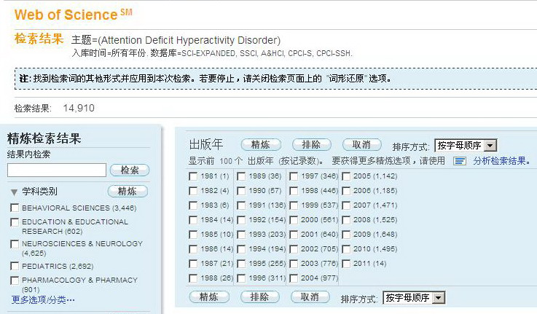
如何快速获取最有价值的科研参考信息
科学的检索方式：主题词检索+引文索引
案例： 注意力缺失/多动症
(Attention Deficit Hyperactivity Disorder，ADHD)
仅通过主题词/关键词检索，查到的参考文献最早为20世纪80年代初
有关ADHD的最早研究是否开始于这段时间？
我们是否真正了解到这项研究的历程和发展？

Slide 22



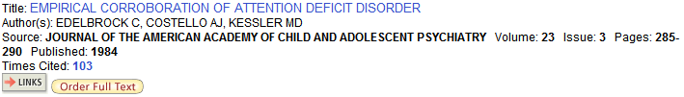
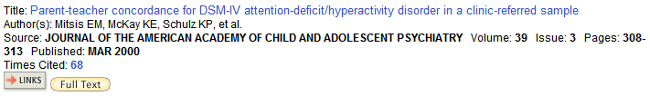
从1902年Still的开创性研究以后，ADHD经历了很多术语名称的变化。通过WoS特有的引文索引，我们可以从不同年代追溯Still 这篇文章的引文，从而了解有关行为障碍的研究领域的发展历程。
1966 儿童多动综合症 (Hyperactive child syndrome)
1978 多动症与轻微脑功能损伤 (Hyperkinetic Minimal Brain Dysfunction)
1984 注意力缺失 (Attention Deficit Disorder)
2000 注意力缺失/多动症 (Attention Deficit Hyperactivity Disorder)
22

Slide 23

Web of Science平台新界面
Notes:
So, in summary, all terms in the topic field are searched – even very common words; there are no stop words. Lemmatization helps automatically find variants of your search terms. Left hand truncation is now allowed. The NEAR operator lets you specify the distance between your search terms . And all search results are returned, allowing for the most accurate set combinations and results analysis.

Slide 24
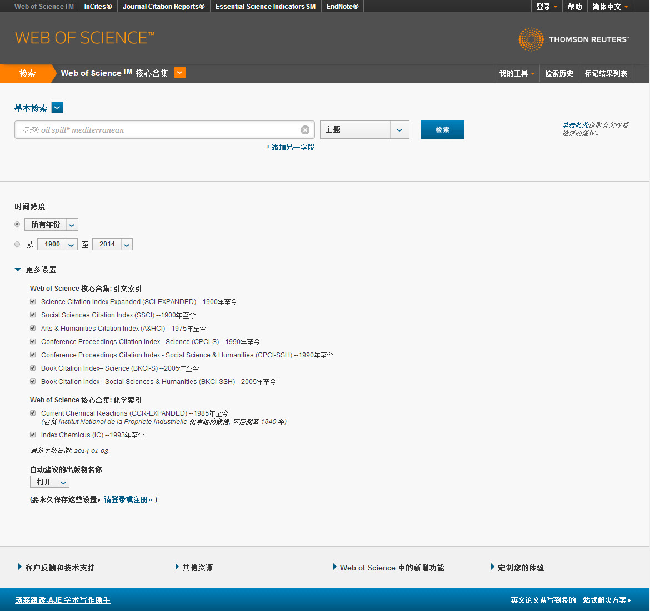
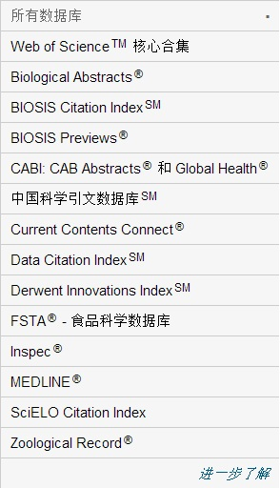
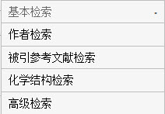
Web of Science核心合集
检索方式下拉列表
Notes:
So, in summary, all terms in the topic field are searched – even very common words; there are no stop words. Lemmatization helps automatically find variants of your search terms. Left hand truncation is now allowed. The NEAR operator lets you specify the distance between your search terms . And all search results are returned, allowing for the most accurate set combinations and results analysis.

Slide 25
如何利用SCI进行课题的选题和创新研究

Slide 26
当我们对学术领域中的某个课题产生兴趣的时候,可以利用SCI来了解这样三个问题……
某一方面的研究以前都有什么人用什么方法做过？
现在人们对这方面的研究有什么最新进展和认识？
目前同一研究领域，不同的实验室是否用了不同的方法展开研究，哪种方法更合理？
通常只有回答了这三个问题，才能说对课题有了一定的了解。
Notes:
在开始之前，我想先给大家看一篇文章，是大连化物所汪其老师传给我的，是大化所孙志刚博士写的，发表在“化学物理通讯”上。在这里我想引述他的话，”大家知道，科研工作者经常要花费大量的时间进行文献查询。当我们对学术领域中的某个课题产生兴趣的时候，头脑里往往浮现的是这样两个问题：这方面的研究以前都有什么人用什么方法做过？现在人们对这方面的研究有什么最新进展和认识？通常只有回答了这两个问题，才能说对课题有了一定的了解。一般来说，解决这两个问题的方法，就是利用手头上已了解到的信息去查找相关刊物，复印资料，然后依据其参考文献去寻根刨底。幸运的话，初始的手头信息来自于最近期刊，这样不仅可以了解到这个研究课题的历史，而且也看到了其最新发展。这个过程是需要花费一定时间的，从事科研工作的每个人都会有同感吧。如果不幸的话，手头的资料并不是最近发表的，这时想要了解某个研究课题的最新进展，就要靠自己花费大量时间浏览所在学科相关期刊上面最新发表的文章。但是，随着科学的发展，年年都有与本学科相关的新增学术期刊，依靠以往那种“每个月抽出一定时间去浏览相关期刊的当月刊”的做法，早已不能适应我们对信息获取的要求。这时该怎么办？ “

Slide 27

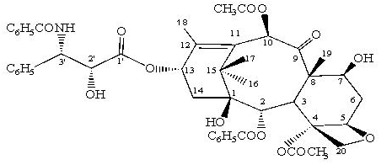
紫杉醇：紫杉醇是美国北卡罗莱纳州三角研究所的Wall博士和Wani博士于1967年发现的，并在1971年发表了这一研究成果。紫杉醇是目前所了解的惟一一种可以促进微管聚合和稳定已聚合微管的药物。同位素示踪表明， 紫杉醇只结合到聚合的微管上， 不与未聚合的微管蛋白二聚体反应。细胞接触紫杉醇后会在细胞内积累大量的微管，这些微管的积累干扰了细胞的各种功能，特别是使细胞分裂停止于有丝分裂期，阻断了细胞的正常分裂。 紫杉醇主要适用于卵巢癌和乳腺癌，对肺癌、大肠癌、黑色素瘤、头颈部癌、淋巴瘤、脑瘤也都有一定疗效。
紫杉醇
3000棵树=10吨树皮=1kg=500病人

Slide 28
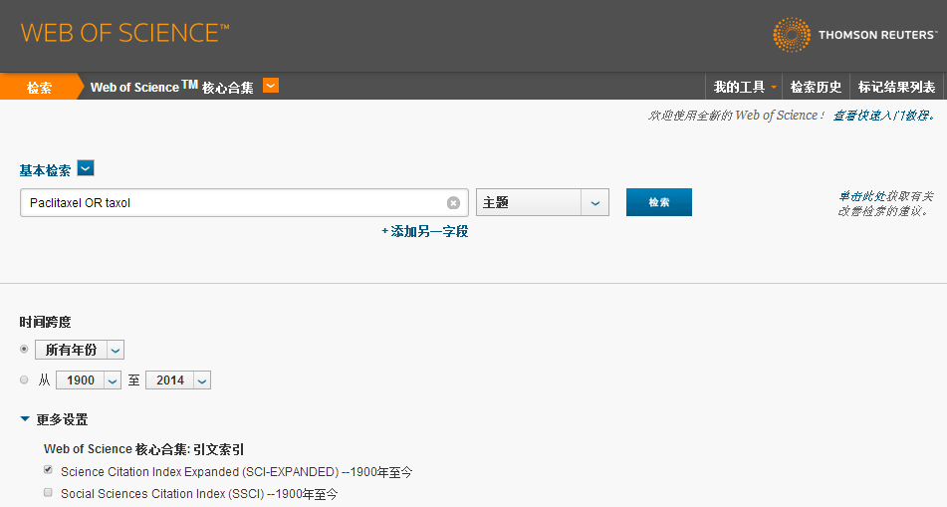
案例：抗癌药物 ——— 紫杉醇
检索词： Paclitaxel OR taxol
检索字段：主题
检索数据库：SCI

Slide 29
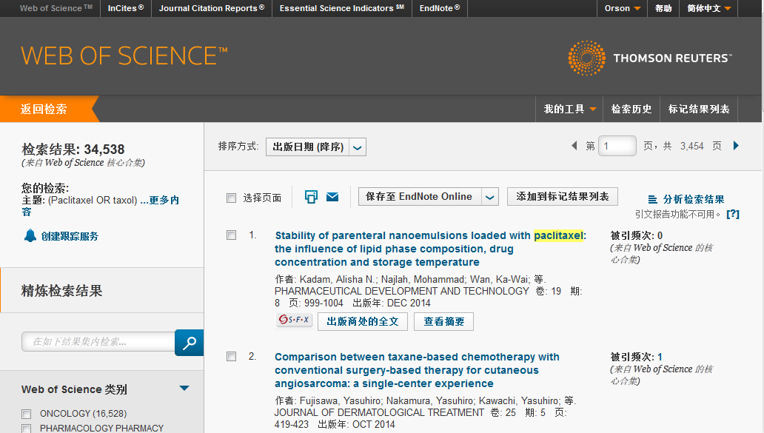
案例：抗癌药物 ——— 紫杉醇

Slide 30

科技文献的获取途径

Slide 31

对检索结果文献进行分析
相关课题前景
重点参考文献
课题发展历史
课题研究前沿
课题重点研究机构
…

Slide 32
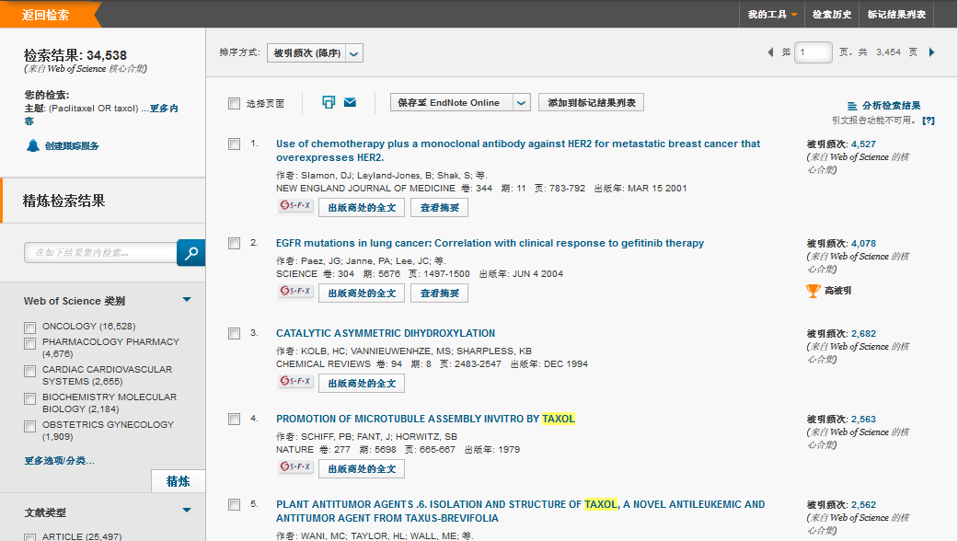
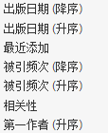
如何快速锁定高影响力的论文？
Notes:
被引用次数多表示受关注程度高，不一定是被同行认可程度高

Slide 33
1979 年，美国爱因斯坦医学院（Albert Einstein College of Medicine）的分子药理学家Susan B. Horwitz 博士阐明了紫杉醇独特的抗肿瘤作用机制：紫杉醇可使微管蛋白和组成微管的微管蛋白二聚体失去动态平衡，诱导与促进微管蛋白聚合、微管装配、防止解聚，从而使微管稳定并抑制癌细胞的有丝分裂和防止诱导细胞凋亡，进而有效阻止癌细胞的增殖起到抗癌作用。

Slide 34
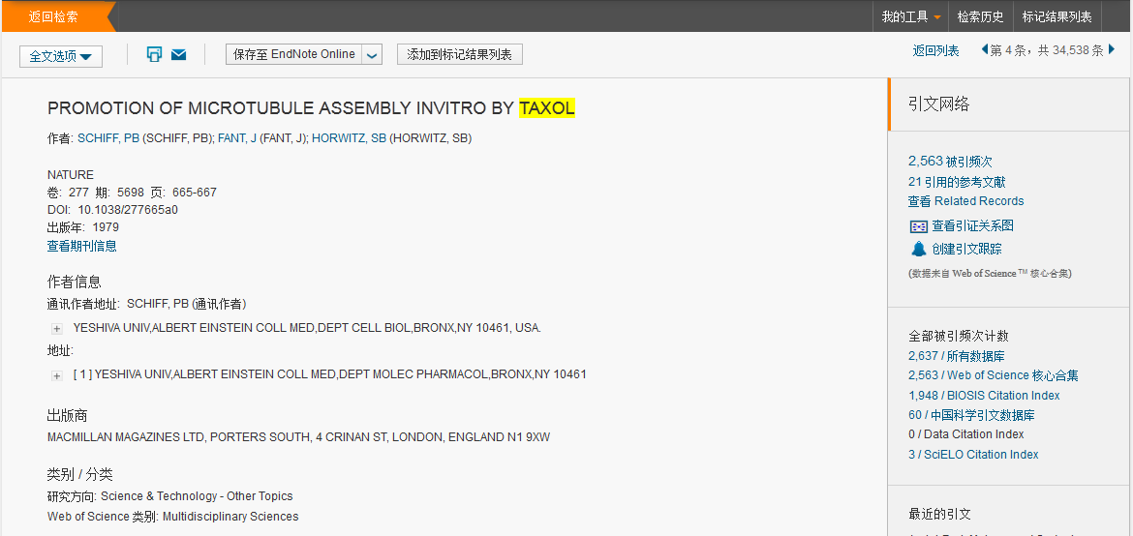

Slide 35
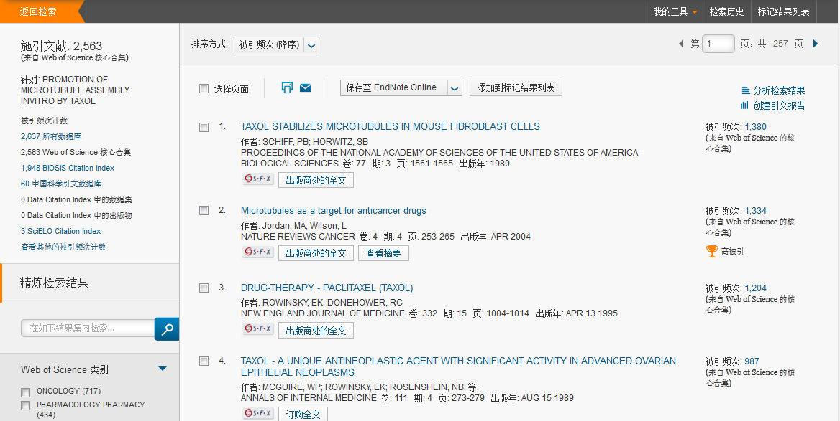
紫杉醇稳定老鼠纤维细胞中的微管

Slide 37
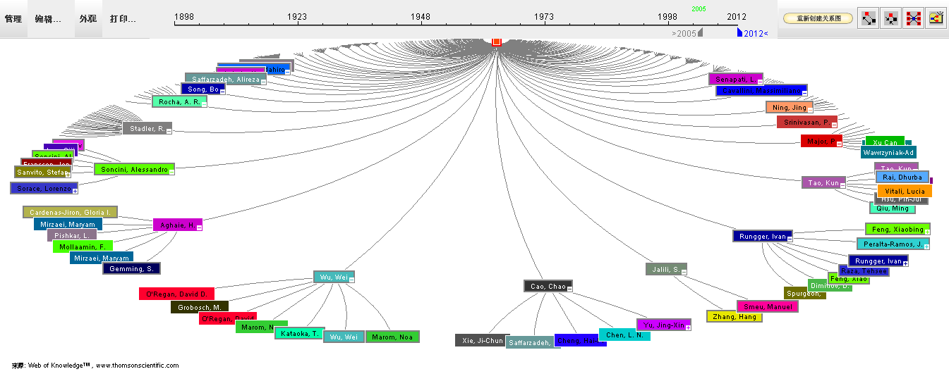
和施引文献的关系：追踪后续进展
通过活跃节点捕捉后续进展
Notes:
二代引用影响力更大的节点，文献计量学睡美人现象

Slide 39
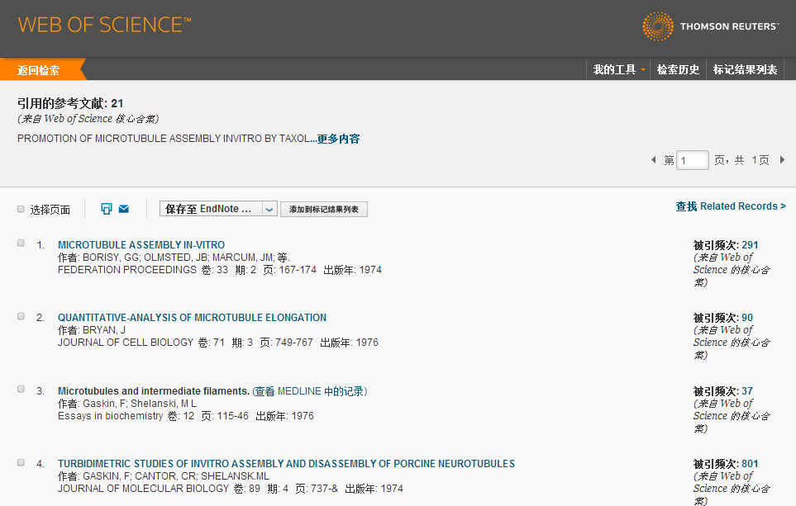
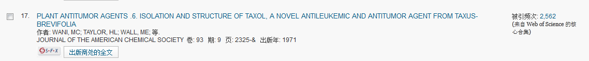
紫杉醇的发现来源

Slide 41
Web of Science中的相关记录
论文甲
论文乙
Synthesis of Amino Acids
Synthesis of Amino Acids
Synthesis and/or collection of Synthesis and/or collection of amino acids is critical for cell survival. They not only serve as the building blocks for proteins but also as starting points for the synthesis of many important cellular molecules including vitamins and nucleotides.
Synthesis and/or collection of Synthesis and/or collection of amino acids is critical for cell survival. They not only serve as the building blocks for proteins but also as starting points for the synthesis of many important cellular molecules including vitamins and nucleotides.
Synthesis of Amino Acids
Synthesis of Amino Acids
Synthesis of Amino Acids
Synthesis of Amino Acids
Synthesis of Amino Acids
Synthesis of Amino Acids
Synthesis and/or collection of Synthesis and/or collection of amino acids is critical for cell survival. They not only serve as the building blocks for proteins but also as starting points for the synthesis of many important cellular molecules including vitamins and nucleotides.
Synthesis and/or collection of Synthesis and/or collection of amino acids is critical for cell survival. They not only serve as the building blocks for proteins but also as starting points for the synthesis of many important cellular molecules including vitamins and nucleotides.
Synthesis and/or collection of Synthesis and/or collection of amino acids is critical for cell survival. They not only serve as the building blocks for proteins but also as starting points for the synthesis of many important cellular molecules including vitamins and nucleotides.
Synthesis and/or collection of Synthesis and/or collection of amino acids is critical for cell survival. They not only serve as the building blocks for proteins but also as starting points for the synthesis of many important cellular molecules including vitamins and nucleotides.
Synthesis and/or collection of Synthesis and/or collection of amino acids is critical for cell survival. They not only serve as the building blocks for proteins but also as starting points for the synthesis of many important cellular molecules including vitamins and nucleotides.
Synthesis and/or collection of Synthesis and/or collection of amino acids is critical for cell survival. They not only serve as the building blocks for proteins but also as starting points for the synthesis of many important cellular molecules including vitamins and nucleotides.
A B C D E F

Slide 43
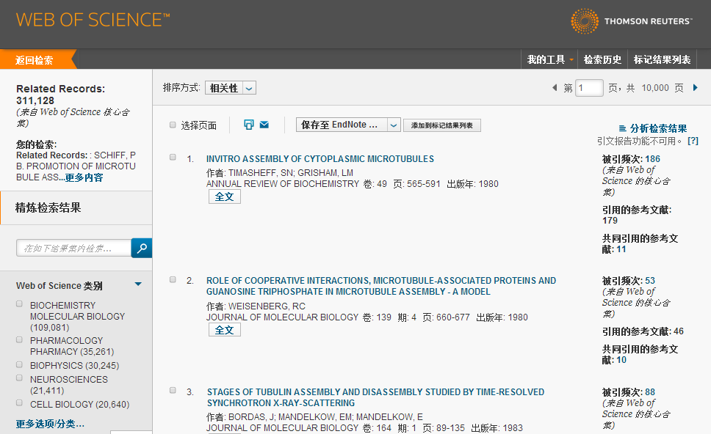
结果数：311,128

Slide 44
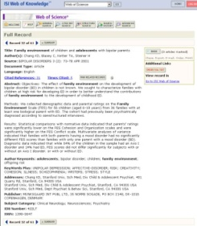
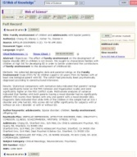
引文索引－通过文献的引证关系了解课题的发展脉络
从一篇高质量的文献出发，沿着科学研究的发展道路…
越查越新
2010
越查越深
Times Cited
2008
Cited References
2002
2003
2006
1998
Related Records
1993
1991
2004
2002
1980
1999
越查越广
1994
44
Notes:
您可以轻松的回溯某一研究文献的起源与历史，或者追踪其最新的进展，即可以越查越旧，也可以越查越新，越查越深入

Slide 45
如何从整体上把握课题的发展方向和趋势？
如何选择合作者？
如何快速把握学科内学术热点？
如何选择合适的期刊投稿？

Slide 46
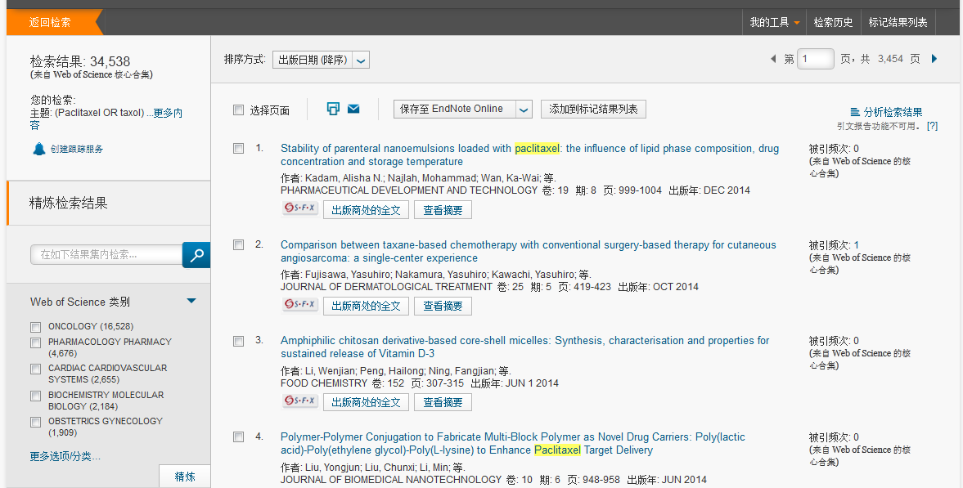
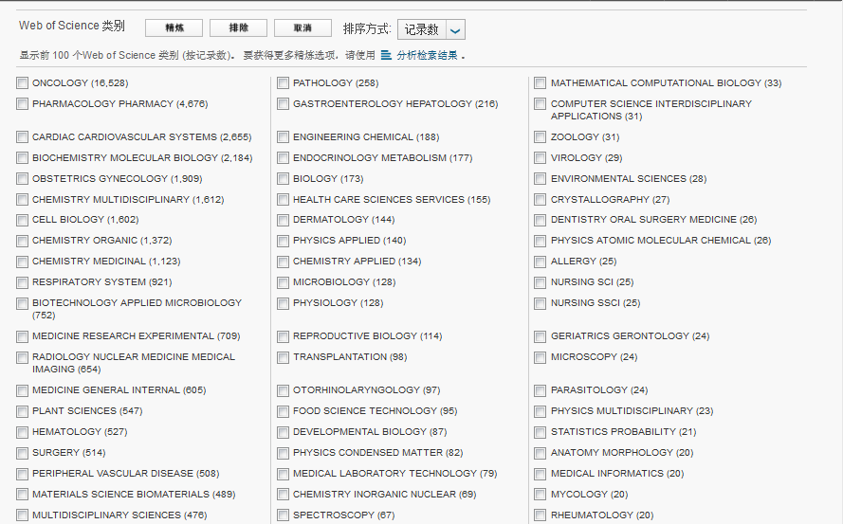
如何快速找到课题内高影响力的文章？
心血管系统（2655）

Slide 47
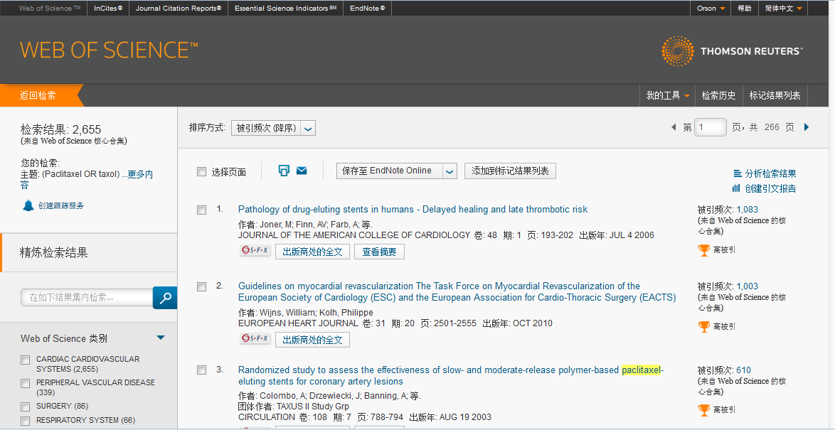

Slide 48
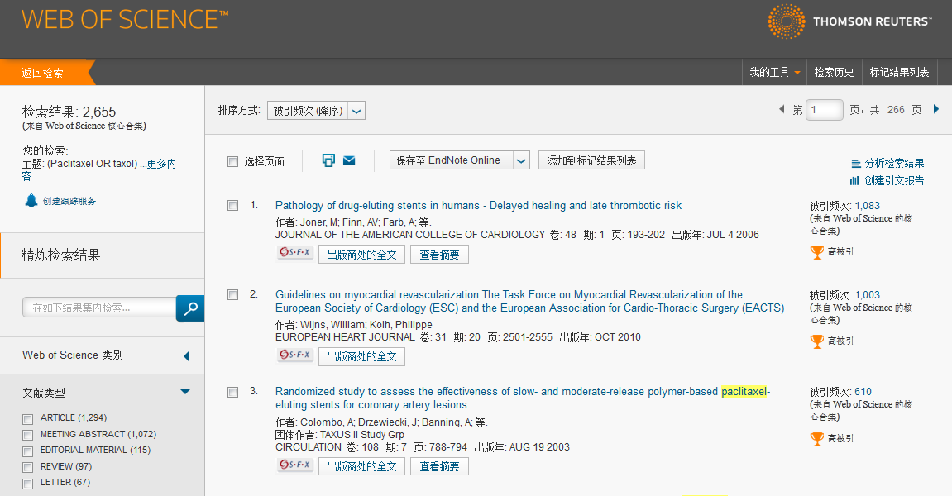
如何快速找到高影响力、最新的综述？
REVIEW (97)

Slide 49
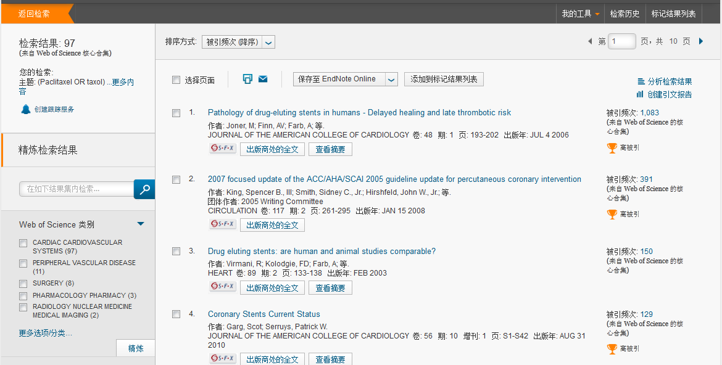

Slide 50
SCI收录文献类型——新闻
SARS、海啸、禽流感、汶川地震、 奥运会等热点研究以新闻形式被SCI收录仅次于研究论文，并且大多发表在影响因子很高的如《Nature》、《Science》、《Lancet》、《Cell》等著名期刊上。
阅读SCI收录的科学新闻能够帮助科学工作者更好的了解研究热点。
对热点研究利用SCI分析发现非论文形式发表的新闻文章占了很高的比率，突发性灾害后该研究的文献被SCI收录急速增长并引用数量猛增。

Slide 51
利用科学新闻做选题研究（三聚氰胺案例）
Title: Food safety agency invites comments on melamine decisions
Author(s): [Anon]
Source: JAVMA-JOURNAL OF THE AMERICAN VETERINARY MEDICAL ASSOCIATION Volume: 231 Issue: 1 Pages: 17-17 Published: JUL 1 2007
SCI收录43篇三聚氰胺新闻，其中和食品有关的新闻有5篇

Slide 52
《Nature》、《Science》、《Cell》、《Lancet》
刊登新闻的比例
检索2008年《Nature》、《Science》、《Cell》、《Lancet》
著名期刊被SCI数据库收录文献会发现（8月1日检索数据）
《Nature》研究论文536篇（33.3748 %），社论420篇（26.1519 %），新闻292篇（18.1818 %）；
《Science》研究论文514篇，32.9065 %，新闻396篇（25.3521 %），社论340篇（21.7670 %）；
《Cell》研究论文216篇（48.7585 %），社论100篇（22.5734 %），新闻81篇（18.2844 %）。
2000-2008年10月《Lancet》共被SCI收录20449篇文献，其中通讯6856篇（33.5273 %）、社论5357篇（26.1969 %）、论文3827篇（18.7149 %）、新闻2788篇（13.6339 %）、评论683篇（3.3400 %）

Slide 53
阅读科学新闻可以帮助科学工作者快速了解研究热点
获得研究思路，选择研究课题 。

Slide 54
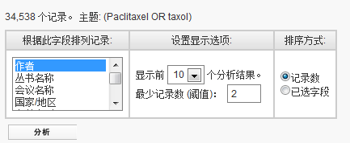
强大的分析功能：
▪作者 ▪出版年 ▪来源期刊 ▪文献类型 ▪会议名称 ▪国家/地区
▪基金资助机构 ▪授权号 ▪团体作者 ▪机构 ▪语种 ▪学科类别
▪ WOS学科类别 ▪编者 ▪丛书名称

Slide 55
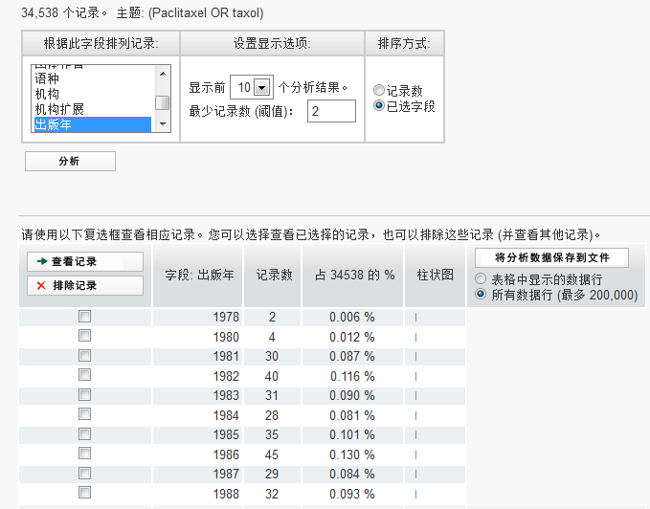
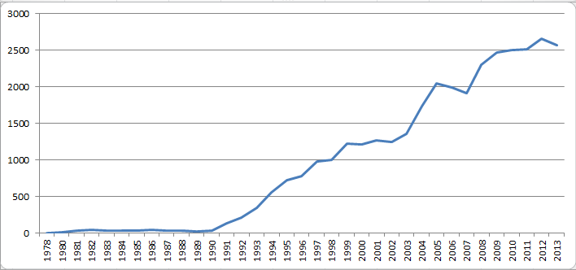
出版年分析：了解课题的发展趋势以及判断课题的发展阶段。

Slide 56
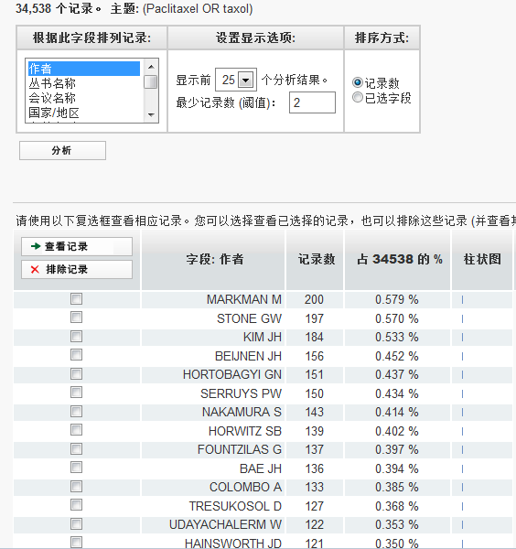

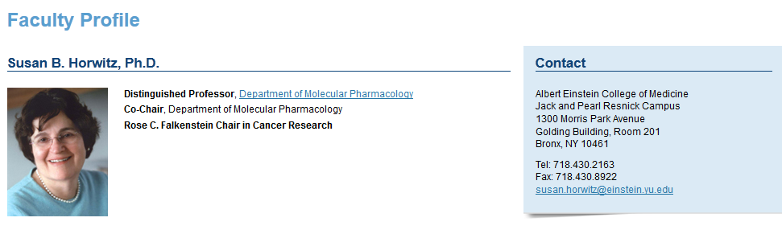
著者分析：
- 发现该领域的高产出研究人员
- 有利于机构的人才招聘
选择小同行审稿专家
选择潜在的合作者
Maurie Markman 教授，就职于美国癌症治疗中心
Susan B. Horwitz教授，就职于爱因斯坦医学院

Slide 57
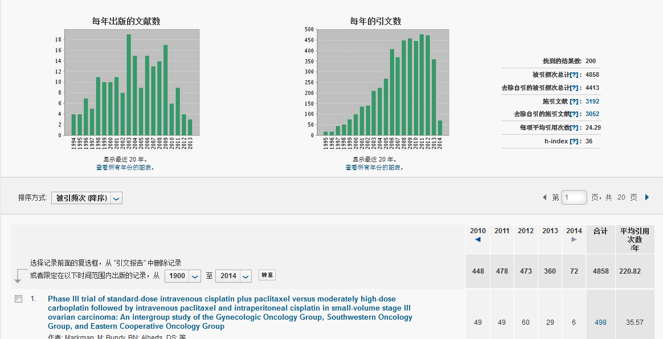
通过引用高影响力作者的高影响力文章来获得自己论文的加分

Slide 58
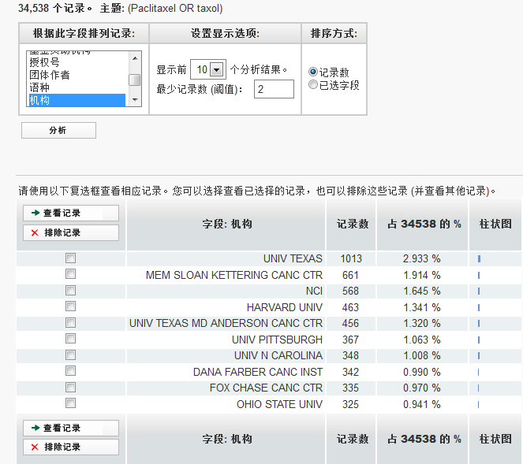

机构
- 发现该领域高产出的大学及研究机构
有利于机构间的合作
发现深造的研究机构
德克萨斯大学
纪念斯隆-凯特琳癌症中心
美国国家癌症研究所
德克斯大学安德森癌症中心

Slide 59
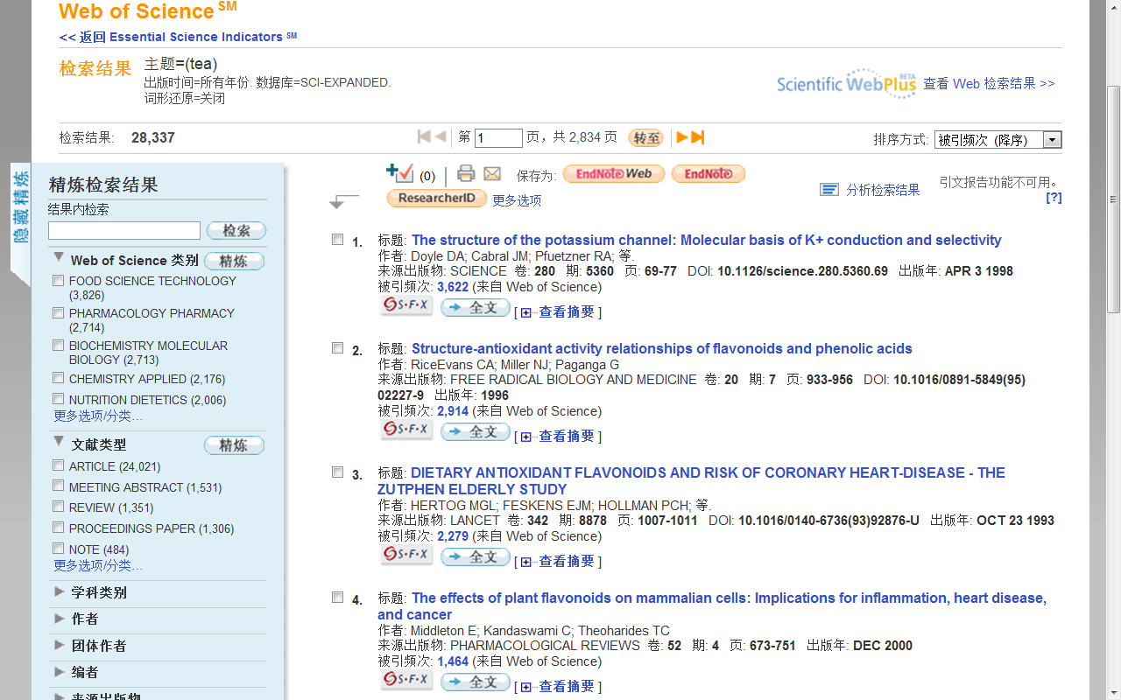
利用SCI寻找茶叶研究国际合作机构

Slide 60
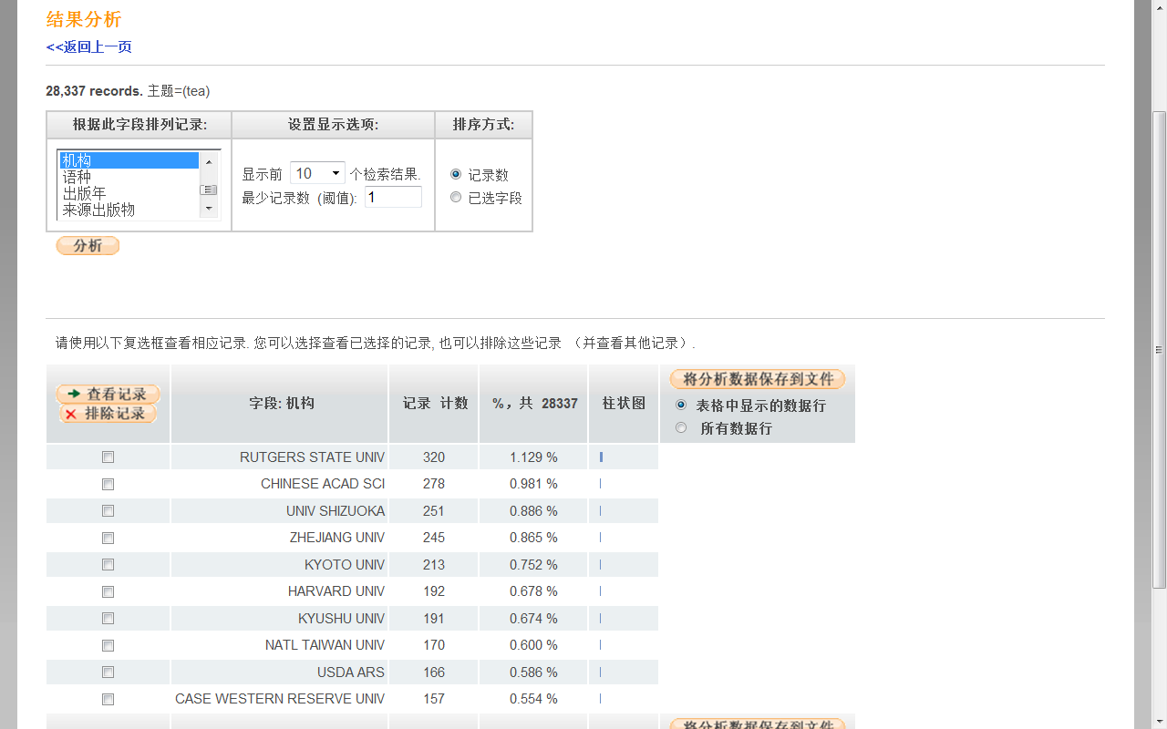
利用SCI寻找茶叶研究国际合作机构
涉及茶叶研究机构11412个
茶叶十大研究机构：罗特格斯州立大学、中国科学院、静冈大学 、浙江大学、京都大学 、哈佛大学 、九州大学、美国农业部农业研究服务署、台湾大学、凯斯西储大学

Slide 61
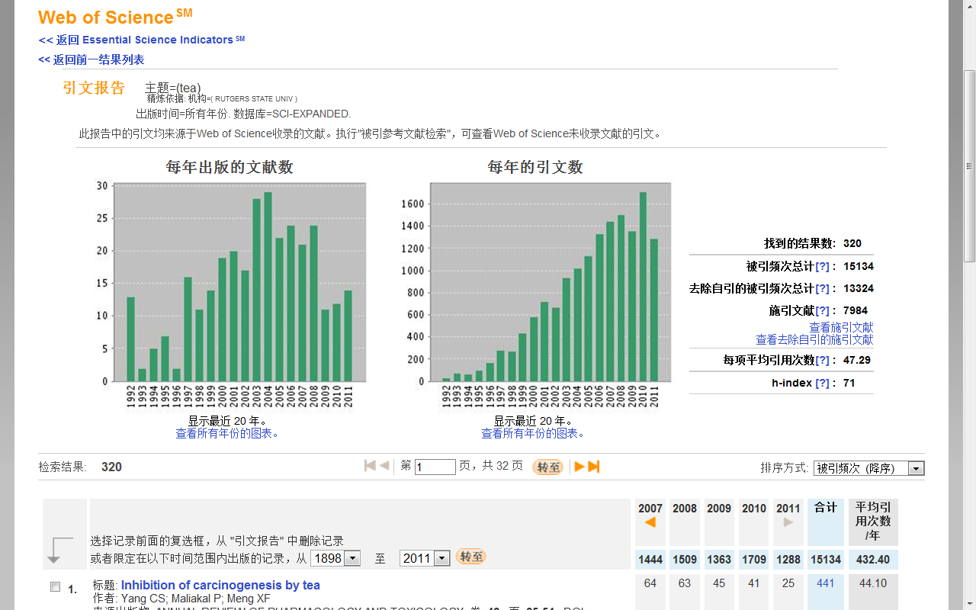
罗特格斯州立大学（Rutgers State Univ）发表了320篇主题中有茶叶的论文，共被引15134次，平均引用47.29次， H指数为71（有71篇文章每篇最少被引用71次）。

Slide 62
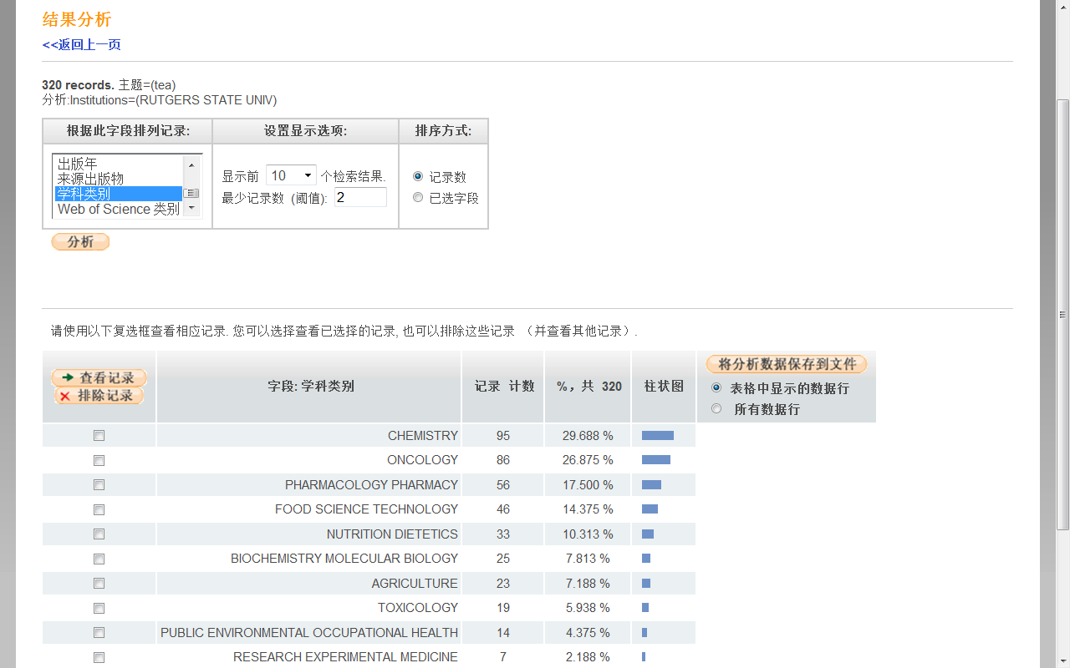
利用SCI寻找茶叶研究国际合作机构
罗特格斯州立大学(Rutgers State Univ)发表320篇主题中有茶叶的论文涉及到主要学科：化学、肿瘤学 、药理学、食品、营养学、生物化学与分子生物学 、农业、毒理学

Slide 63
高被引论文的作者多为多国混合型。
美国是中国高被引论文的主要合作者，有美国参与的高被引论文的相对值大约是中国高被引论文相对值的5倍。

Slide 64


期刊
帮助选择合适的投稿期刊
临床肿瘤学杂志

Slide 65
如果稿件投向了不合适的期刊会遭遇：
退稿：内容“不适合本刊”，使稿件延迟数周或数月发表；
不公正的同行评议：由于编辑和审稿人对作者研究领域的了解比较模糊，从而有可能导致稿件受到较差或不公正的同行评议；
少有同行关注：埋没在一份同行很少问津的期刊中，达不到与小同行交流的目的。也可能从没有被人引用。

Slide 66





Slide 67






利用此功能发现中国在该领域:
  引领机构, 高产出, 高影响力的作者
  经常发表中国作者论文的期刊
  与中国学者合作的国家和机构
  该课题在中国的发展趋势
  等等……
国家和地区：发现该领域高产出的国家与地区
元英进副校长，天津大学

Slide 68


Slide 69

引文报告呈现该领域的总体趋势
迅速锁定领域内的高影响力/高热点论文

Slide 70


获取全文方式

Slide 71


Slide 72

开放获取
Web of Science核心合集检索结果
新增对OA期刊文章的精炼
Notes:
So, in summary, all terms in the topic field are searched – even very common words; there are no stop words. Lemmatization helps automatically find variants of your search terms. Left hand truncation is now allowed. The NEAR operator lets you specify the distance between your search terms . And all search results are returned, allowing for the most accurate set combinations and results analysis.

Slide 73
索取全文

Slide 74




获取全文的途径

Slide 75
如何让科学研究更有效率，更有乐趣 ？
Web of Science的管理和写作功能
Notes:
75
科研工作中,收集和整理文献资料是一个重要的环节,常常要花费很多时间和精力,而且查找整理后的资料也要花费不少时间.原来收集、整理文献资料的方法,已经无法适应目前科技的发展速度了.在收集参考文献过程中,文献管理程序可以帮助你整理、排列、检索、浏览、阅读所收集的内容;
撰写研究论文的过程中,这类程序允许你直接在文字处理过程中插入参考文献,并按要求自动调整引用顺序,可根据投稿期刊的不同要求快速修改参考文献的引用并生成规定格式的参考文献列表.
软件优点：
1、 杂志的要求自动生产参考文献，所以在写文章的时候你再也不要考虑如何根据杂志的要求进行排版了。 2、随时调整参考文献的格式。使用这些软件可以在需要的时候随时调整参考文献的格式。 3、方便自己查找文献。可以把自己读过的参考文献全部输入到Endnote里头，这样在查找的时候就非常方便。 4、 参考文献库一经建立，以后在不同文章中作引用时，既不需重新录入参考文献，也不需仔细地人工调整参考文献的格式。而且参考文献很多情况下可以直接从网上下载导入至库中，很方便。可谓一劳永逸。 5、对文章中的引用进行增、删、改以及位置调整都会自动重新排好序。文章中引用处的形式(如数字标号外加中括号的形式，或者是作者名加年代的形式，等等) 以及文章后面参考文献列表的格式都可自动随意调整。这对修改退稿准备另投它刊时特别有用。 6、 EndNote处理中文有点问题，主要是显示不正确，但其功能不受影响。实际上，真正的不方便之处在于中英文混合引用的时候。这时，由于习惯不同，中英文文献格式会出再混乱。比如，某个文献的多位中文作者排列时出现类似“刘某某,张某某,et al”字样而不是中文习惯里的“刘某某、张某某，等”字样。 7、与WORD的真正协同功能。安装了EN后，自动在WORD中建立了一个新的工具栏，我们在写作时最常用的几项功能都只需简单点击这个工具栏即可。

Slide 76
利用Web of Science跟踪最新研究进展
怎样利用Web of Science 将有关课题的最新文献信息自动发送到您的Email邮箱?
  定题跟踪
  引文跟踪

Slide 77



保存检索历史 创建定题跟踪
定期检索相关课题，并把最新结果发送到指定的邮箱中
有效期半年，到时间后可以续订

Slide 78

创建引文跟踪－随时文献的掌握最新进展
全纪录页面（创建引文跟踪）
引文跟踪
某一理论有没有得到进一步的证实？是否已经应用到了新的领域？
某项研究的最新进展极其延伸？
某个实验方法是否得到改进？
对于某个研究问题后来有没有勘误和修正说明?
本人的论文被谁引用了?

Slide 79
高质量论文的收藏和管理
理想的收藏方式
  能对我的参考文献进行统一管理收藏
  可以对我的参考文献进行分类
  可以对我的参考文献进行联合检索
  Endnote Online

Slide 80


Slide 81



对于WOS平台重要文献的管理

Slide 82

手动输入

Slide 83

导入其它数据库来源的文献。

Slide 84





Slide 85


通过txt格式导入参考文献(本地计算机上选择文件)

Slide 86

通过 EndNote web 优化您的论文写作
可检索收录的文章
有效分类组织参考文献
链接到原记录，相关记录，施引文献

Slide 87

通过 EndNote web 优化您的论文写作
管理参考文献资料
易于学习/工作组之间的交流
教授—为研究生提供阅读书目
图书馆馆员—为科研人员提供相应的参考文献

Slide 88
遵循拟投稿期刊的体例要求
您知道吗? -参考文献的格式会影响稿件的录用
编辑对稿件的 “第一眼印象”
不同的领域,不同的期刊都有不同的参考文献格式要求
Endnote Online

Slide 89

通过 EndNote web 优化您的论文写作

Slide 90
通过 Endnote 优化您的论文写作
与Microsoft Word自动连接, 边写作边引用
自动生成文中和文后参考文献
提供3000多种期刊的参考文献
按拟投稿期刊的格式要求自动生成参考文献, 节约了大量的时间和精力
对文章中的引用进行增、删、改以及位置调整都会自动重新排好序
修改退稿, 准备另投它刊时, 瞬间调整参考文献格式

Slide 91

通过 Endnote 优化您的论文写作
安装cite while you write插件后word的界面，点击后会自动连接网络SCI
需要在此处添加铃木零先生于1995年撰写的文章为参考文献

Slide 92

通过 EndNote web 优化您的论文写作
将您在Endnote中的相关参考文献数据导入

Slide 93

通过 EndNote web 优化您的论文写作
选中目标文献，点击插入

Slide 94

通过 EndNote web 优化您的论文写作
参考文献则已经被插入文章最末端

Slide 95

通过 EndNote web 优化您的论文写作
如文章想改投其他杂志，则可通过点选内置的3000多种杂志格式轻易修改参考文献格式

Slide 96

通过 EndNote web 优化您的论文写作
已经修改为Nature的杂志格式

Slide 97
Endnote Web – 文献的管理和写作工具
与Microsoft Word自动连接, 边写作边引用
  自动生成文中和文后参考文献
  提供3300多种期刊的参考文献格式
提高写作效率:
  按拟投稿期刊的格式要求自动生成参考文献, 节约了大量的时间和精力
  对文章中的引用进行增、删、改以及位置调整都会自动重新排好序
  修改退稿, 准备另投它刊时, 瞬间调整参考文献格式
Notes:
直接在文字处理过程中插入参考文献,并按要求自动调整引用顺序,可根据投稿期刊的不同要求快速修改参考文献的引用并生成规定格式的参考文献列表.
软件优点：
1、 杂志的要求自动生产参考文献，所以在写文章的时候你再也不要考虑如何根据杂志的要求进行排版了。 2、随时调整参考文献的格式。使用这些软件可以在需要的时候随时调整参考文献的格式。 3、方便自己查找文献。可以把自己读过的参考文献全部输入到Endnote里头，这样在查找的时候就非常方便。 4、 参考文献库一经建立，以后在不同文章中作引用时，既不需重新录入参考文献，也不需仔细地人工调整参考文献的格式。而且参考文献很多情况下可以直接从网上下载导入至库中，很方便。可谓一劳永逸。 5、对文章中的引用进行增、删、改以及位置调整都会自动重新排好序。文章中引用处的形式(如数字标号外加中括号的形式，或者是作者名加年代的形式，等等) 以及文章后面参考文献列表的格式都可自动随意调整。这对修改退稿准备另投它刊时特别有用。 6、 EndNote处理中文有点问题，主要是显示不正确，但其功能不受影响。实际上，真正的不方便之处在于中英文混合引用的时候。这时，由于习惯不同，中英文文献格式会出再混乱。比如，某个文献的多位中文作者排列时出现类似“刘某某,张某某,et al”字样而不是中文习惯里的“刘某某、张某某，等”字样。 7、与WORD的真正协同功能。安装了EN后，自动在WORD中建立了一个新的工具栏，我们在写作时最常用的几项功能都只需简单点击这个工具栏即可。

Slide 98

利用Web of Science来提高您的科研工作流程

Slide 99





ISI Web of Knowledge – 基于科研人员工作流程
ISI Web of Knowledge:
检索
分析
管理
写作
投稿
Notes:
99

Slide 100



自从拥有了Web of Science……

Slide 101

学习资源，网址http://ip-science.thomsonreuters.com.cn/
学术写作助手
英文论文从写到投的一站式解决方案
模块1：WOS大讲堂（科研及研发人员）
3月-6月 每周二 晚7:00-8:00
模块2： WOK大讲堂（图书馆员与情报分析人员）
4月-5月 每周四下午15:00-16:00

Slide 102


免费查询某期刊当前是否被Web of Science收录
http://ip-science.thomsonreuters.com/mjl/

Slide 103

Stop Searching Start Discovering
汤森路透 杨习斌
13401089564
Orson.yang@thomsonreuters.com

